Slide 1
UML Activity Diagram
An activity diagram is essentially a flowchart that shows activities performed by a system.
Activity diagram is basically a flowchart to represent the flow from one activity to another activity. The activity can be described as an operation of the system.
The control flow is drawn from one operation to another. This flow can be sequential, branched, or concurrent. Activity diagrams deal with all type of flow control by using different elements such as fork, join, etc
Captures the dynamic behavior of the system

Slide 2
The purpose of an activity diagram can be described as −
Draw the activity flow of a system.
Describe the sequence from one activity to another.
Describe the parallel, branched and concurrent flow of the system.

Slide 3
Basic components of an activity diagram
Some of the most common components of an activity diagram include:
Action: A step in the activity wherein the users or software perform a given task. Actions are symbolized with round-edged rectangles.
Decision node: A conditional branch in the flow that is represented by a diamond. It includes a single input and two or more outputs.
Control flows: Another name for the connectors that show the flow between steps in the diagram.
Start node: Symbolizes the beginning of the activity. The start node is represented by a black circle.
End node: Represents the final step in the activity. The end node is represented by an outlined black circle.

Slide 4
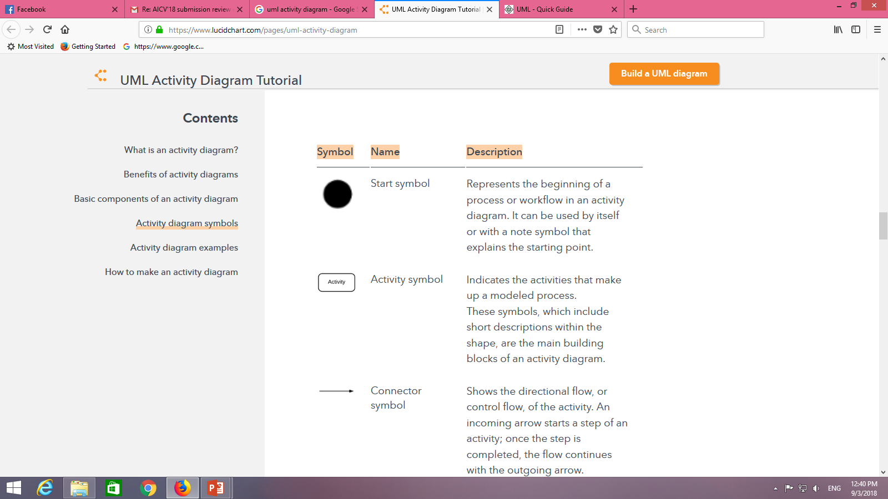
Activity diagram symbols

Slide 5
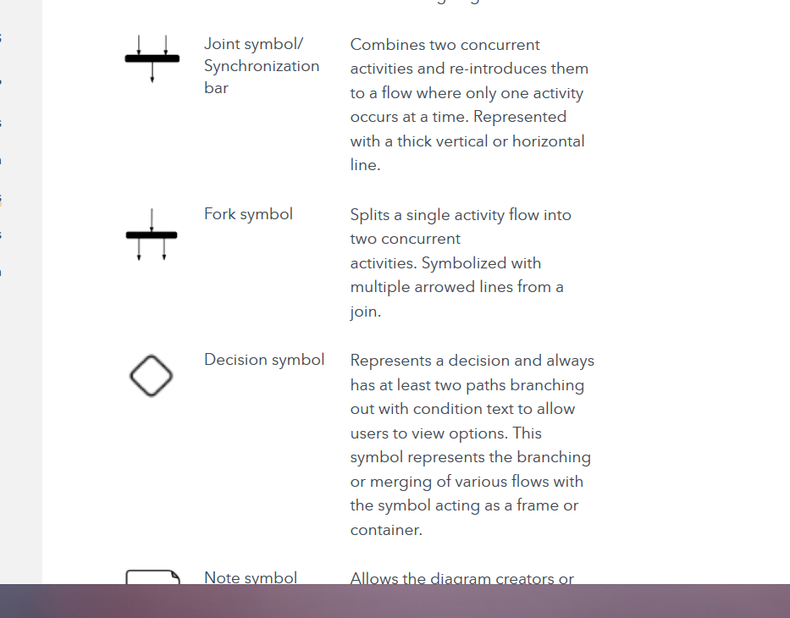

Slide 6
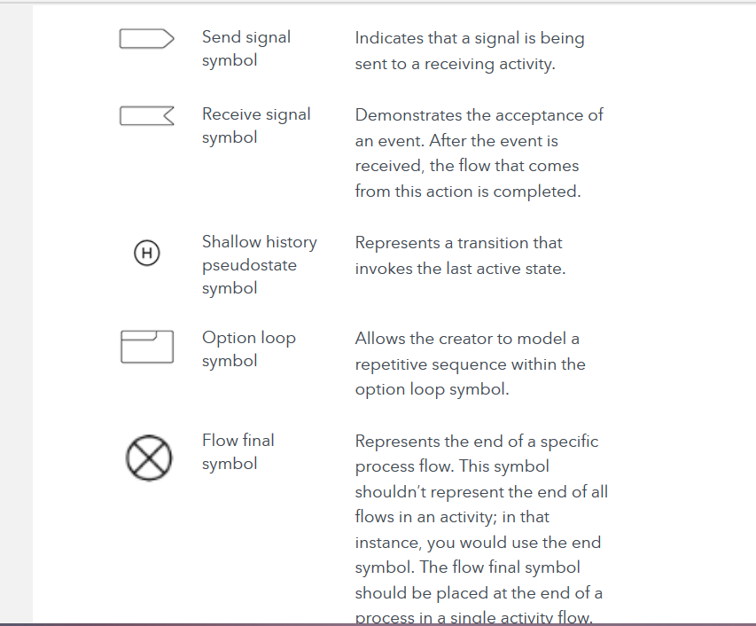

Slide 7
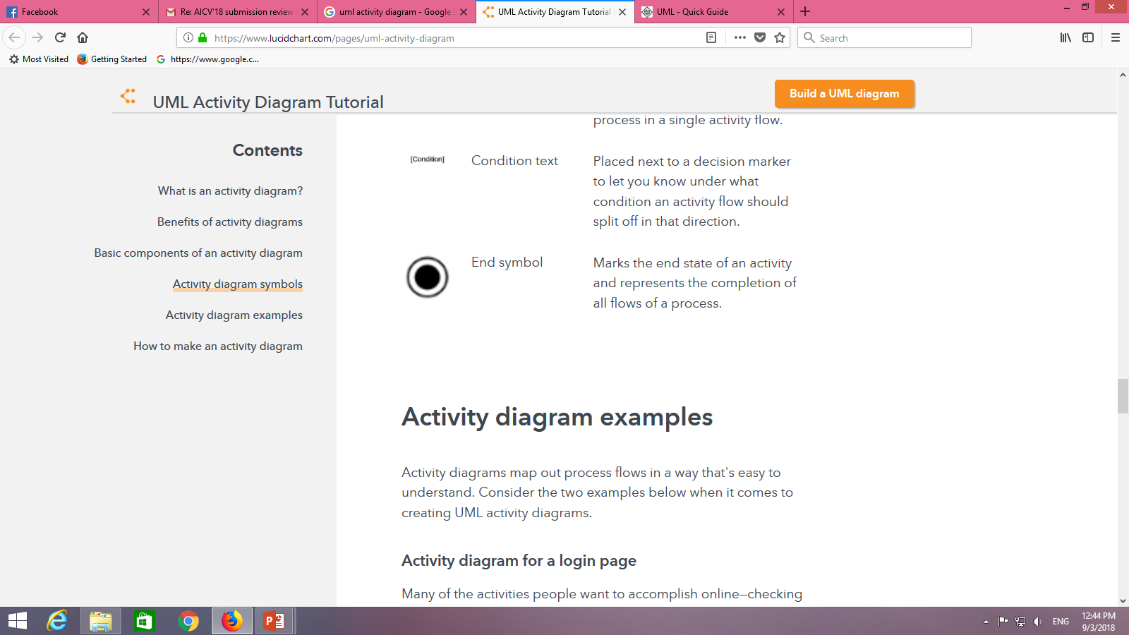

Slide 8
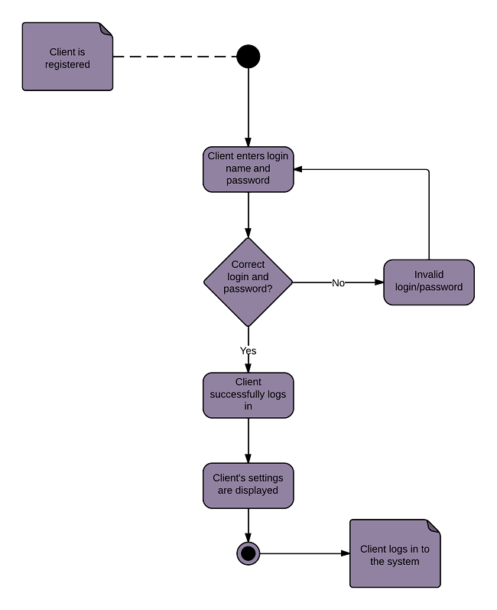

Slide 9
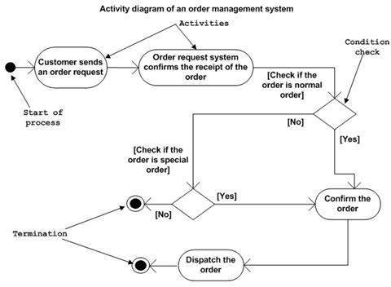

Slide 10
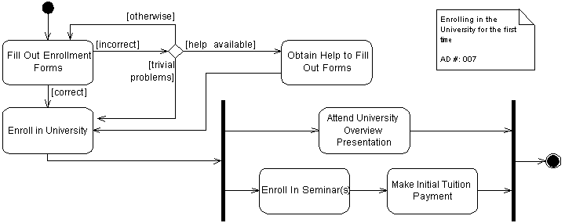

Slide 11
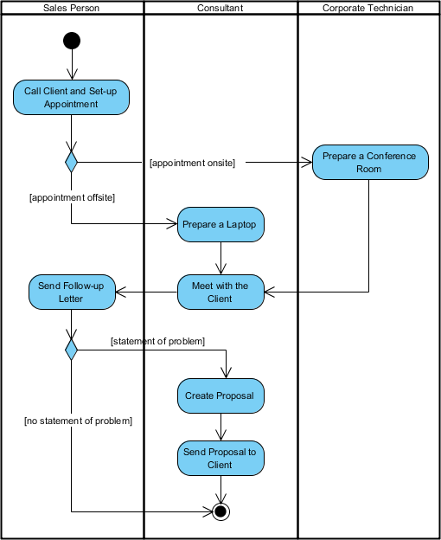

Slide 12
